Slide 1
Pancasila in Indonesia Nation History Studies Session 03
Course : CB Pancasila
Effective Period : 2017

Slide 2

Student will be able to explain the history of the birth of Pancasila
thepeakperformancecenter.com

Slide 3
Introduction
The Repertoire of Indonesian Culture
The Kutai Kingdom
→ The value of Beliving in God and Spirituality
The Sriwijaya Kingdom
→ The value of spirituality, society and economy
The Majapahit Kingdom
→ Pancasila Krama in “Nagarakertagama” written by Empu Tantular

Slide 4
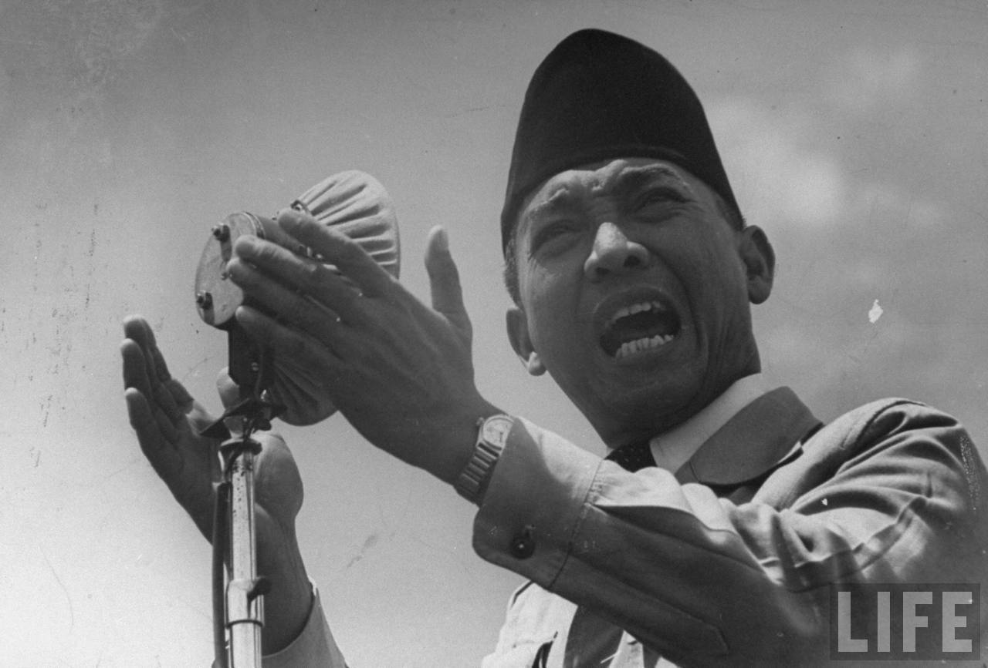
Introduction
penasoekarno.files.wordpress.com
Soekarno: “Never forget your history”.
Cicero (106-43): Historia Vitae Magistra =
A history teaches the wisdom.
The values ​​of Pancasila born from the Indonesian Culture

Slide 5
The History of Pancasila
The Pre-Independence of Indonesia era
Independence of Indonesia era:
- Orde Lama (The Old Era)
- Orde Baru (The New Era)
- Reform era

Slide 6
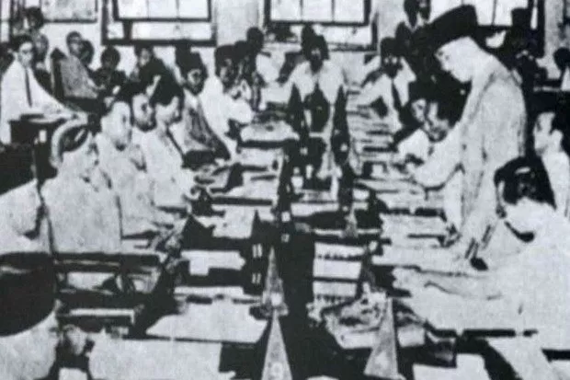
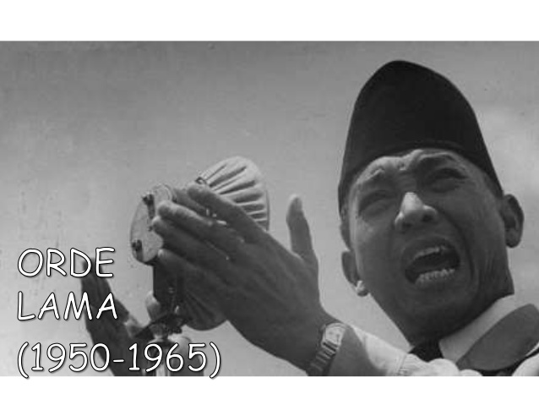
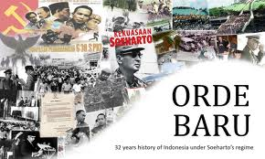
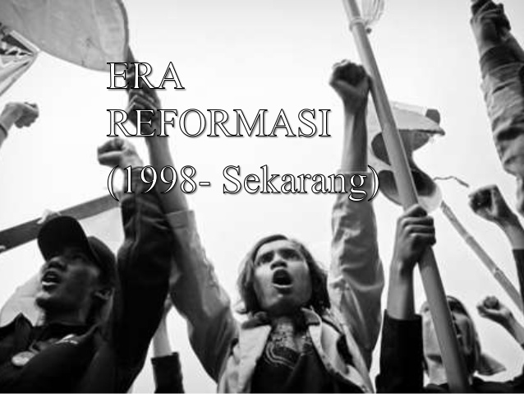
Discussion
Sidang PPKI
Based on the history of Pancasila, according to your opinion / group what should be done by the current generation to maintain the integrity of Pancasila

Slide 7
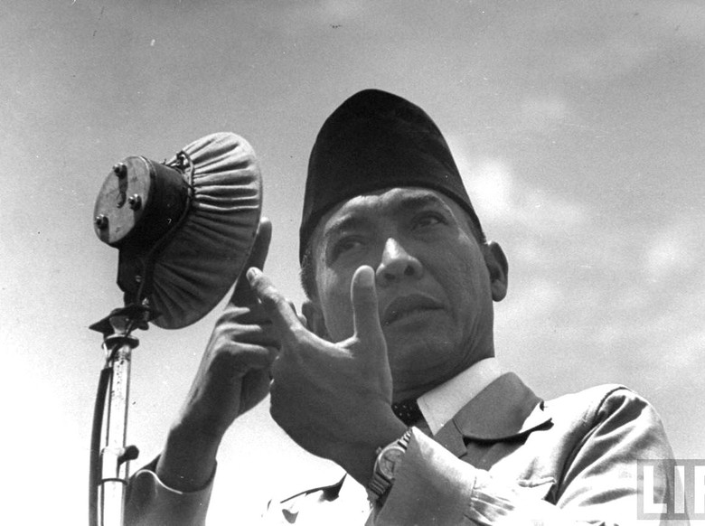
Case Study
Read the article based on the following link …. And give your opinion
Relate it to the current condition
https://news.detik.com/berita/3222960/ini-pidato-bung-karno-1-juni-1945-yang-jadi-cikal-bakal-lahirnya-pancasila

Slide 8
Question and Answer
?

Slide 9
References
Tim Penulis CB: Pancasila (2014). Diktat Kuliah Character Building: Pancasila. Jakarta: Binus University: CBDC
Materi Ajar Matakuliah Pendidikan Pancasila (2013). Buku Modul Kuliah Pancasila oleh Direktorat Pembelajaran dan Kemahasiswaan Direktorat Jenderal Pendidikan Tinggi Depdiknas , Kementerian Pendidikan dan Kebudayaan RI.
Lahirnya Pancasila: http://id.wikipedia.org/wiki/Lahirnya_Pancasila
Gambar Learning Objective: thepeakperformancecenter.com
Gambar Soekarno: penasoekarno.files.wordpress.com
Gambar Soekarno dalam sidang: https://www.satujam.com/sejarah-pancasila/
gambar orde baru: http://sokhi95.blogspot.co.id/2013/04/makalah-mengenai-orde-lama-orde-baru.html
gambar reformasi : https://www.slideshare.net/nandatasia/orde-lama-orde-baru-dan-reformasi
Gambar soekarno orde lama: https://www.slideshare.net/nandatasia/orde-lama-orde-baru-dan-reformasi
Gambar Soekarno dan case study : https://news.detik.com/berita/3222960/ini-pidato-bung-karno-1-juni-1945-yang-jadi-cikal-bakal-lahirnya-pancasila

